Slide 1

E-VISA MANAGEMENT SYSTEM

Slide 2
TEAM MEMBERS:- 2200031579-N.Mohana priya 2200031598-R.L.Sri Meghana
TEAM MEMBERS:-
ID NO NAME
2200031579 N. MOHANAPRIYA
2200031598 R.L. SRI MEGHANA

Slide 3
CONTENTS:-
INTRODUCTION
MODULES
PIE CHARTS
CUSTOMER JOURNEY MAP
CONCLUSION

Slide 4

INTRODUCTION:-
E-visa management refers to the electronic processing and administration of visa applications and related processes. E-visas, or electronic visas, are a digital version of traditional visas that allow travelers to enter a foreign country for a specified period and purpose. The introduction of e-visa systems aims to streamline and modernize the visa application process, making it more efficient, secure, and convenient for both applicants and immigration authorities

Slide 5

MODULES:-
User Registration Module
Application Form Module
Document Upload Module
Payment Gateway Module
Security and Authentication Module

Slide 6
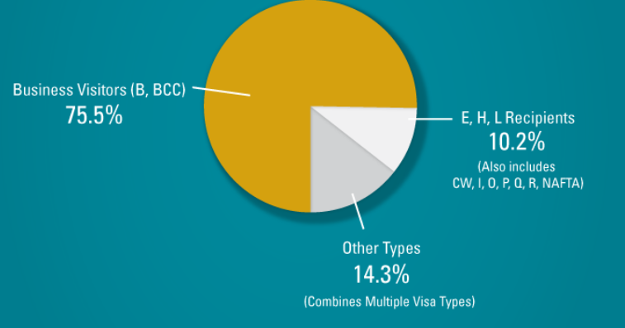
PIE CHART:-

Slide 7
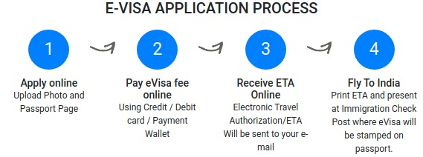
CUSTOMER JOURNEY MAP:-

Slide 8


TECHNOLOGIES TO BE USED:-
HTML, CSS
PYTHON
DATABASE: SQL,MYSQL

Slide 9
CONCLUSION:-
E-Visa Management Systems have become integral components of modern immigration processes, offering a range of benefits for both governments and travelers. The adoption of electronic visa systems represents a significant advancement in the efficiency, security, and accessibility of visa application procedures.

Slide 10


